Slide 1
Digging cassandra cluster
Ivan Burmistrov
Notes:
Hello everybody.
My today’s talk “Digging Cassandra Cluster” will be about how to determine the most problem tables in Cassandra Cluster.
“The most problem” means “tables that create problems not only for itself but for other tables too”.

Slide 2
Who am i?
Ivan Burmistrov
Tech Lead at SKB Kontur
5+ years Cassandra experience (from Cassandra 0.7)
burmistrov@skbkontur.ru
@isburmistrov
https://www.linkedin.com/in/isburmistrov/en
Notes:
Before we start let me give short overview about who I am and about my company.
My name is Ivan Burmistrov.
I’m tech lead of one of the teams at “SKB Kontur”. I started to use Cassandra in production about 5 years ago from version 0.7.

Slide 3
SKB Kontur
Services for businesses
B2B: e-Invoicing
B2G: e-reporting of tax returns to government
Notes:
SKB Kontur – company in Russia focuses on services for business.
In particular, “business to business” services: for example, electronic Invoices between trading partners
“business to government” services: for example, electronic reporting of tax returns to government
So, the core part of almost all our services is storage and delivery of critical electronic documents.

Slide 4


retail
Notes:
In particular, my team focuses on electronic document interchange between retailers and suppliers of products.
Example of retailer on the slide here is Auchan. Auchan, for those who don’t know, is big European chain store like Walmart.
Suppliers of products are companies like Procter & Gamble, Nestle and Coca-Cola.
Every day retailers order products from suppliers through our service and expect this products will be in shops on time.

Slide 5

Requirements
24 x 7 x 365
Guarantee of delivering
Notes:
So, our service is business critical because it is on the critical path of delivering products to customers in shops.
And our clients expect from constant availability us guarantee of delivering electronic documents.
And because of reliability requirements we chose Cassandra.
What about the document delivery time?
This part of requirements is pretty soft: we just need to guarantee delivery time not exceed one minute.
One minute!? Sounds like “infinite”, isn’t it? Yes, we thought as well, because we built our service based on Cassandra and it just worked.
And of course we passed this delivery time requirement without any difficulties.

Slide 6
Requirements
24 x 7 x 365
Guarantee of delivering
Delivery time <= 1 minute
Notes:
So, our service is business critical because it is on the critical path of delivering products to customers in shops.
And our clients expect from constant availability us guarantee of delivering electronic documents.
And because of reliability requirements we chose Cassandra.
What about the document delivery time?
This part of requirements is pretty soft: we just need to guarantee delivery time not exceed one minute.
One minute!? Sounds like “infinite”, isn’t it? Yes, we thought as well, because we built our service based on Cassandra and it just worked.
And of course we passed this delivery time requirement without any difficulties.

Slide 7
When Cassandra just works
Notes:
So, we were relaxed, careless and we added, added, added features into our service. And, as result, we added, added, added tables into cluster.
We didn’t think about performance.

Slide 8

When Cassandra just works
Notes:
So, we were relaxed, careless and we added, added, added features into our service. And, as result, we added, added, added tables into cluster.
We didn’t think about performance.

Slide 9
When Cassandra just works
Notes:
So, we were relaxed, careless and we added, added, added features into our service. And, as result, we added, added, added tables into cluster.
We didn’t think about performance.

Slide 10

Smart guy
Notes:
This guy thought about performance for us.
But one day our happy days finished: we started to violate the soft delivery time requirement.
And we found our cluster in bad condition.

Slide 11
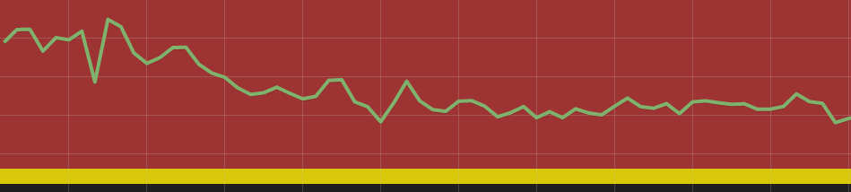
The problem
150+ different tables in cluster (Cassandra 1.2)
Client read latency (99th percentile): 100ms – 2.0s
Affected almost all tables
CPU: 40% – 80%
Disk: not a problem
2 sec.
Notes:
There were more than 150 different tables in the cluster.
“Different” means different pattern of usage, different data model, different number of requests...
Client read latency ranged from 100 milliseconds to 2 seconds and affected almost all tables.
On the slide you can see a plot of client read latency, 99th percentile .
And the problem was in that with so high read latency almost all subsystems started to work slow and unacceptable.
When we looked on basic indicators of machines with Cassandra, we found that CPU utilization was pretty high: from 40 percent to 80 percent.
At the same time, disk’s indicators was absolutely normal, so we concluded that we have issue with CPU.
We started investigation and tried to understand the reason for the terrible latency.

Slide 12
Hypothesis 1: anomalies in metrics
ReadLatency.99thPercentile
node’s latency of processing read request
ReadLatency.OneMinuteRate
node’s read requests per second
SSTablesPerReadHistogram
how many SSTables node reads per read request
Notes:
If you find any presentation or an article about understanding problems in Cassandra, it almost certainly will contain words “Look at metrics, search anomalies”.
And of course we followed this sensible recommendation.
On the slide you can see some interesting metrics.
But these metrics (and all other metrics) didn’t help us. Because high CPU Utilization we saw bad read latency values across almost all of our tables.
For other metrics, in particular, SSTablesPerReadHistogram, we saw many pretty similar tables.
For example, for 65 tables Cassandra processed 3 SSTables per read at average. Was it good or bad values? We didn’t know.
The same situation was for almost all other metrics.
So, we failed to find bad tables. Or probably were in horrible situation and didn’t have bad tables? We didn’t know.
And so, we started to check other hypotheses.
Говорю много чисел, а на слайде не отражены.

Slide 13
Hypothesis 1: anomalies in metrics
ReadLatency.99thPercentile
node’s latency of processing read request
ReadLatency.OneMinuteRate
node’s read requests per second
SSTablesPerReadHistogram
how many SSTables node reads per read request
Tables were pretty similar in these metrics
What values are good, which are bad?
Notes:
If you find any presentation or an article about understanding problems in Cassandra, it almost certainly will contain words “Look at metrics, search anomalies”.
And of course we followed this sensible recommendation.
On the slide you can see some interesting metrics.
But these metrics (and all other metrics) didn’t help us. Because high CPU Utilization we saw bad read latency values across almost all of our tables.
For other metrics, in particular, SSTablesPerReadHistogram, we saw many pretty similar tables.
For example, for 65 tables Cassandra processed 3 SSTables per read at average. Was it good or bad values? We didn’t know.
The same situation was for almost all other metrics.
So, we failed to find bad tables. Or probably were in horrible situation and didn’t have bad tables? We didn’t know.
And so, we started to check other hypotheses.
Говорю много чисел, а на слайде не отражены.

Slide 14
Hypothesis 2: Compaction
Decrease/increase compaction throughput
Change compaction strategy
Notes:
OK, what other processes in Cassandra can cause high CPU usage?
We suspected compaction.
For check this hypothesis we tried to decrease compaction throughput, increase it, change the compaction strategy.
Nothing changed. Absolutely no changes both in latency and CPU utilization.

Slide 15
Hypothesis 2: Compaction
Decrease/increase compaction throughput
Change compaction strategy
Nothing changed
Notes:
OK, what other processes in Cassandra can cause high CPU usage?
We suspected compaction.
For check this hypothesis we tried to decrease compaction throughput, increase it, change the compaction strategy.
Nothing changed. Absolutely no changes both in latency and CPU utilization.

Slide 16
Hypothesis 3: GC
ParNew GC – 6 seconds per minute (10%!)
Read good articles about Cassandra and GC
http://tech.shift.com/post/74311817513/cassandra-tuning-the-jvm-for-read-heavy-workloads
http://aryanet.com/blog/cassandra-garbage-collector-tuning
Tried to tune
Notes:
OK, probably GC is our enemy?
We observed high GC activity: node spent in GC about 6 second per minute.
We read many good articles about how to tune GC, many successful stories about tuning GC for Cassandra (some links on the slide). And we tried to follow recommendations from these articles.
But nothing changed.
What did we wrong? Why nothing helped?
We stopped check hypothesis blindly. We needed more information about what our cluster actually did.

Slide 17
Hypothesis 3: GC
ParNew GC – 6 seconds per minute (10%!)
Read good articles about Cassandra and GC
http://tech.shift.com/post/74311817513/cassandra-tuning-the-jvm-for-read-heavy-workloads
http://aryanet.com/blog/cassandra-garbage-collector-tuning
Tried to tune
Nothing changed
Notes:
OK, probably GC is our enemy?
We observed high GC activity: node spent in GC about 6 second per minute.
We read many good articles about how to tune GC, many successful stories about tuning GC for Cassandra (some links on the slide). And we tried to follow recommendations from these articles.
But nothing changed.
What did we wrong? Why nothing helped?
We stopped check hypothesis blindly. We needed more information about what our cluster actually did.

Slide 18
Java Mission Control and Java Flight Recorder
Built-in profiling tool from Oracle JDK 7 Update 40
Low performance overhead: 1-2%
Useful for CPU profiling: hot threads, hot methods, call stacks,…
Profiling results: 70% of time – SSTablesReader
Notes:
To understand it we chose Java Mission Control and Java Flight Recorder – built-in profiling tools from Oracle JDK 7 Update 40.
It has low overhead – from 1 to 2 percent and useful for CPU profiling: contains reports about hot threads, hot methods, call stacks.
We launched one of the nodes under the profiler. And the result was the following: 70 percent of time was spent in SSTablesReader.

Slide 19
What tables cause most reads of SSTables?
SSTablesPerReadHistogram did not help
We needed another metric
SSTablesPerSecond
how many SSTables each table read per second
SSTablesPerSecond = SSTablesPerReadHistogram.Mean *
ReadLatency.OneMinuteRate
Notes:
OK, so the key question was “what tables cause most reads of SSTables?”.
As we remember, SSTablesPerReadHistogram did not help us, we needed another metric.
And we decided if we had SSTablesPerSecond metric (that is how many SSTables each table read per second), it could help us.
Fortunately we can calculate this metric approximately by multiplication SSTablesPerReadHistogram.Mean and ReadLatency.OneMinuteRate metrics.
We did it, and let’s see to a graph of this metric.

Slide 20
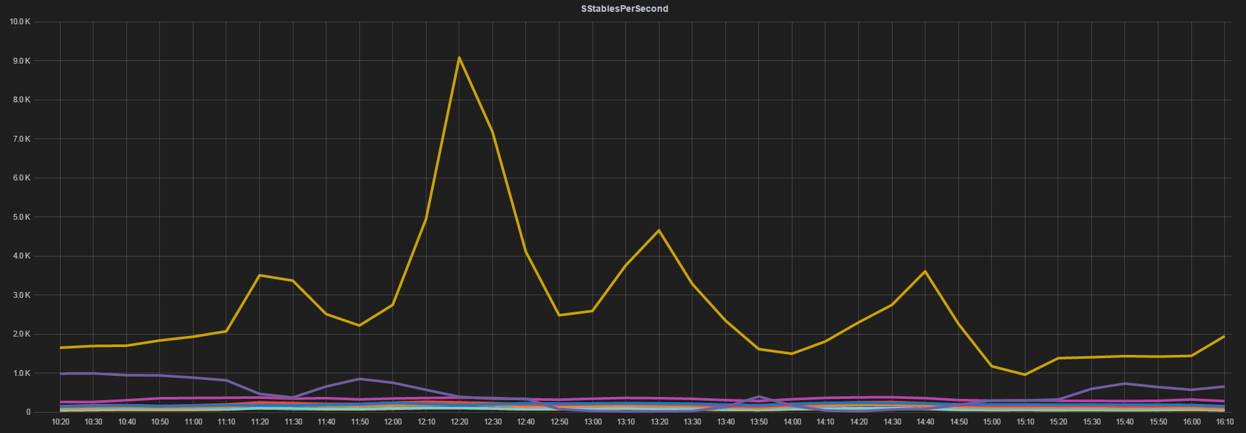
SSTablesPerSecond
Notes:
Each line on this graph is values of metric SSTablesPerSecond for some table.
This is screenshot of our real graph that we got then, except one detail:
here we see one obvious leader that dominates, but actually we found 7 such leaders.
I hid other leaders for demonstrate difference between them and other tables.

Slide 21
SSTablesPerSecond: results
7 leading tables = only 7 candidates for deep investigation
Large difference between leaders and others
Almost all leaders were surprises
3 types of problems
Notes:
So, the results of analysis of this metric were followings:
- We found 7 leading tables, so only 7 candidates for deep investigation
The difference between leaders and others was huge, so we hoped that fixing this tables could have a positive effect on entire cluster
And one interesting remark. All leaders were surprises for us. It means that we did not expect that these tables could cause problems for the cluster.
Moreover, the tables were not in leaders neither in read rate nor SSTablesPerRead metrics. They were near the middle in both metrics, but after multiplication they became the leaders, as we saw.
When we found 7 candidates, we started to investigate why each of these tables read so many SSTables. And we found 3 types of problems within these tables.

Slide 22
Problem 1: Invalid timestamp usage
CREATE TABLE users_lastaction (
user_id uuid,
subsystem text,
last_action_time timestamp,
PRIMARY KEY (user_id)
);
subsystem: ‘API‘,‘WebApplication‘,…
Notes:
First type is “Invalid timestamp usage”.
We had a table where for each user we stored last activity time within each of our subsystems.
For example, last activity in web application, or in API, or any subsystem we can imagine.
And each subsystem wrote into this table individually, so they did not intersect in stored data.

Slide 23
Problem 1: Invalid timestamp usage
First subsystem:
INSERT INTO users_lastaction
(user_id, subsystem, last_action_time)
VALUES (62c36092-82a1-3a00-93d1-46196ee77204,‘API',‘2011-02-03T04:05:00');
Second subsystem:
INSERT INTO users_lastaction
(user_id, subsystem, last_action_time)
VALUES (62c36092-82a1-3a00-93d1-46196ee77204,‘WebApp',‘2011-02-08T07:05:00')
USING TIMESTAMP 635774040762020710;
Time in ticks,
10000 ticks = 1 millisecond
Notes:
Let’s see an example of writing data into this table by two subsystems.
First subsystem doesn’t use USING TIMESTAMP instruction, but second uses it. And for timestamp uses current time in ticks.
As we know, if we don’t use USING TIMESTAMP instruction, then Cassandra coordinator calculates it for us as current time in microseconds.
So, second subsystem uses timestamps that ten times bigger than first subsystem uses.
Exactly same situation was in our system.
But these subsystems don’t intersect in stored data, so it seems that it is not too serious bug.
But we had problems, why?

Slide 24




Problem 1: Invalid timestamp usage
SELECT last_action_time FROM users_lastaction
WHERE user_id = 62c36092-82a1-3a00-93d1-46196ee77204
AND subsystem = ‘API'
Memtable
SSTables
Notes:
To understand it, let’s remember how Cassandra processes read requests.
Assume we have such read query.
There are Memtable and several SSTables. First, Cassandra looks at memtable. And assume column in memtable was found.
After that, Cassandra filters SSTables using bloom filter.
And after that Cassandra filters SSTables according to timestamps. It deletes from consideration SSTables with maximum timestamp lower than column's timestamp that was read from Memtable.
This great optimization was implemented in CASSANDRA-2498 issue ticket.
At the next step Cassandra reads column from remaining SSTables and returns most recent column.
OK, lets go back to our example.

Slide 25
Problem 1: Invalid timestamp usage
SELECT last_action_time FROM users_lastaction
WHERE user_id = 62c36092-82a1-3a00-93d1-46196ee77204
AND subsystem = ‘API'
Looks at Memtable
Memtable
SSTables
Notes:
To understand it, let’s remember how Cassandra processes read requests.
Assume we have such read query.
There are Memtable and several SSTables. First, Cassandra looks at memtable. And assume column in memtable was found.
After that, Cassandra filters SSTables using bloom filter.
And after that Cassandra filters SSTables according to timestamps. It deletes from consideration SSTables with maximum timestamp lower than column's timestamp that was read from Memtable.
This great optimization was implemented in CASSANDRA-2498 issue ticket.
At the next step Cassandra reads column from remaining SSTables and returns most recent column.
OK, lets go back to our example.

Slide 26
Problem 1: Invalid timestamp usage
SELECT last_action_time FROM users_lastaction
WHERE user_id = 62c36092-82a1-3a00-93d1-46196ee77204
AND subsystem = ‘API'
Looks at Memtable
Filters SSTables using bloom filter
Memtable
SSTables
Notes:
To understand it, let’s remember how Cassandra processes read requests.
Assume we have such read query.
There are Memtable and several SSTables. First, Cassandra looks at memtable. And assume column in memtable was found.
After that, Cassandra filters SSTables using bloom filter.
And after that Cassandra filters SSTables according to timestamps. It deletes from consideration SSTables with maximum timestamp lower than column's timestamp that was read from Memtable.
This great optimization was implemented in CASSANDRA-2498 issue ticket.
At the next step Cassandra reads column from remaining SSTables and returns most recent column.
OK, lets go back to our example.

Slide 27
Problem 1: Invalid timestamp usage
SELECT last_action_time FROM users_lastaction
WHERE user_id = 62c36092-82a1-3a00-93d1-46196ee77204
AND subsystem = ‘API'
Looks at Memtable
Filters SSTables using bloom filter
Filters SSTables by timestamp (CASSANDRA-2498)
Memtable
SSTables
Notes:
To understand it, let’s remember how Cassandra processes read requests.
Assume we have such read query.
There are Memtable and several SSTables. First, Cassandra looks at memtable. And assume column in memtable was found.
After that, Cassandra filters SSTables using bloom filter.
And after that Cassandra filters SSTables according to timestamps. It deletes from consideration SSTables with maximum timestamp lower than column's timestamp that was read from Memtable.
This great optimization was implemented in CASSANDRA-2498 issue ticket.
At the next step Cassandra reads column from remaining SSTables and returns most recent column.
OK, lets go back to our example.

Slide 28
Problem 1: Invalid timestamp usage
SELECT last_action_time FROM users_lastaction
WHERE user_id = 62c36092-82a1-3a00-93d1-46196ee77204
AND subsystem = ‘API'
Looks at Memtable
Filters SSTables using bloom filter
Filters SSTables by timestamp (CASSANDRA-2498)
Reads remaining SSTables
Memtable
SSTables
Notes:
To understand it, let’s remember how Cassandra processes read requests.
Assume we have such read query.
There are Memtable and several SSTables. First, Cassandra looks at memtable. And assume column in memtable was found.
After that, Cassandra filters SSTables using bloom filter.
And after that Cassandra filters SSTables according to timestamps. It deletes from consideration SSTables with maximum timestamp lower than column's timestamp that was read from Memtable.
This great optimization was implemented in CASSANDRA-2498 issue ticket.
At the next step Cassandra reads column from remaining SSTables and returns most recent column.
OK, lets go back to our example.

Slide 29
Problem 1: Invalid timestamp usage
SELECT last_action_time FROM users_lastaction
WHERE user_id = 62c36092-82a1-3a00-93d1-46196ee77204
AND subsystem = ‘API'
Looks at Memtable
Filters SSTables using bloom filter
Filters SSTables by timestamp (CASSANDRA-2498)
Reads remaining SSTables
Merges result
Memtable
SSTables
Notes:
To understand it, let’s remember how Cassandra processes read requests.
Assume we have such read query.
There are Memtable and several SSTables. First, Cassandra looks at memtable. And assume column in memtable was found.
After that, Cassandra filters SSTables using bloom filter.
And after that Cassandra filters SSTables according to timestamps. It deletes from consideration SSTables with maximum timestamp lower than column's timestamp that was read from Memtable.
This great optimization was implemented in CASSANDRA-2498 issue ticket.
At the next step Cassandra reads column from remaining SSTables and returns most recent column.
OK, lets go back to our example.

Slide 30
Problem 1: Invalid timestamp usage
First subsystem:
INSERT INTO users_lastaction
(user_id, subsystem, last_action_time)
VALUES (62c36092-82a1-3a00-93d1-46196ee77204,‘API',‘2011-02-03T04:05:00');
Second subsystem:
INSERT INTO users_lastaction
(user_id, subsystem, last_action_time)
VALUES (62c36092-82a1-3a00-93d1-46196ee77204,‘WebApp',‘2011-02-08T07:05:00')
USING TIMESTAMP 635774040762020710;
Time in ticks,
10000 ticks = 1 millisecond
Notes:
All columns that were written by API subsystem, have lower timestamp than columns that was written by Web Application subsystem.
So, timestamp optimization doesn’t work when we read columns for API subsystem and therefore we read many more SSTables than actually needed.
Использовать одну систему именования (first/second либо API/WebApp).

Slide 31
Problem 1: Invalid timestamp usage
Fix:
started to use equal timestamp sources for one table
Notes:
The fix of the problem was very simple. We just started to use similar timestamps for all subsystems.

Slide 32
Problem 2: Few writes, many reads
Reads dominates over writes (example – user accounts)
Each read – from SSTable (Memtable already flushed)
Notes:
Second problem was with tables for which number of reads greatly exceeded the number of writes.
An example of such table is user accounts.
For these tables each read was from SSTable because Memtable with requested column almost certainly was already flushed.
To fix the problem we just enabled row cache for these tables.

Slide 33
Problem 2: Few writes, many reads
Reads dominates over writes (example – user accounts)
Each read – from SSTable (Memtable already flushed)
Fix: just enabled row cache
Notes:
Second problem was with tables for which number of reads greatly exceeded the number of writes.
An example of such table is user accounts.
For these tables each read was from SSTable because Memtable with requested column almost certainly was already flushed.
To fix the problem we just enabled row cache for these tables.

Slide 34
Problem 3: Aggressive time series
CREATE TABLE activity_records(
time_bucket text,
record_time timestamp,
record_content text,
PRIMARY KEY (time_bucket, record_time)
);
SELECT record_content FROM activity_records
WHERE time_bucket = ‘2015-05-10 12:00:00'
AND record_time > ‘2015-05-10 12:30:10'
Notes:
Third problem was with aggressive time series data.
Processing time series data is a common usage pattern of Cassandra.
And we use it for storing and analyzing various activities in our system.
We store different activity records and analyze it in background.
But we need a very fast reaction on some type of activity anomalies, so background services is quite aggressively polling time series table for most recent data using query like example on the slide.
Why this is a problem?
To understand it remember again how Cassandra processed read requests.

Slide 35
Problem 3: Aggressive time series
SELECT record_content FROM activity_records
WHERE time_bucket = ‘2015-05-10 12:00:00'
AND record_time > ‘2015-05-10 12:30:10'
Memtable
SSTables
Notes:
Again, Cassandra firstly looks at memtable. Then, filters SSTables using bloom filter.
Unlike read single column Cassandra can’t use timestamp optimization. Because for slice query some columns can be only in SSTables.
But, in CASSANDRA-5514 another great optimization was implemented: Cassandra tracks min and max clustered values per SSTable and filters SSTables that don’t intersect request for sure.
That is, for our example SSTables with obviously less values of record_time will be filtered.
After that, Cassandra finally reads column from remaining SSTables and merges result.

Slide 36
Problem 3: Aggressive time series
SELECT record_content FROM activity_records
WHERE time_bucket = ‘2015-05-10 12:00:00'
AND record_time > ‘2015-05-10 12:30:10'
Looks at Memtable
Memtable
SSTables
Notes:
Again, Cassandra firstly looks at memtable. Then, filters SSTables using bloom filter.
Unlike read single column Cassandra can’t use timestamp optimization. Because for slice query some columns can be only in SSTables.
But, in CASSANDRA-5514 another great optimization was implemented: Cassandra tracks min and max clustered values per SSTable and filters SSTables that don’t intersect request for sure.
That is, for our example SSTables with obviously less values of record_time will be filtered.
After that, Cassandra finally reads column from remaining SSTables and merges result.

Slide 37
Problem 3: Aggressive time series
SELECT record_content FROM activity_records
WHERE time_bucket = ‘2015-05-10 12:00:00'
AND record_time > ‘2015-05-10 12:30:10'
Looks at Memtable
Filters SSTables using bloom filter
Memtable
SSTables
Notes:
Again, Cassandra firstly looks at memtable. Then, filters SSTables using bloom filter.
Unlike read single column Cassandra can’t use timestamp optimization. Because for slice query some columns can be only in SSTables.
But, in CASSANDRA-5514 another great optimization was implemented: Cassandra tracks min and max clustered values per SSTable and filters SSTables that don’t intersect request for sure.
That is, for our example SSTables with obviously less values of record_time will be filtered.
After that, Cassandra finally reads column from remaining SSTables and merges result.

Slide 38
Problem 3: Aggressive time series
SELECT record_content FROM activity_records
WHERE time_bucket = ‘2015-05-10 12:00:00'
AND record_time > ‘2015-05-10 12:30:10'
Looks at Memtable
Filters SSTables using bloom filter
Can’t use CASSANDRA-2498
Memtable
SSTables
Notes:
Again, Cassandra firstly looks at memtable. Then, filters SSTables using bloom filter.
Unlike read single column Cassandra can’t use timestamp optimization. Because for slice query some columns can be only in SSTables.
But, in CASSANDRA-5514 another great optimization was implemented: Cassandra tracks min and max clustered values per SSTable and filters SSTables that don’t intersect request for sure.
That is, for our example SSTables with obviously less values of record_time will be filtered.
After that, Cassandra finally reads column from remaining SSTables and merges result.

Slide 39
Problem 3: Aggressive time series
SELECT record_content FROM activity_records
WHERE time_bucket = ‘2015-05-10 12:00:00'
AND record_time > ‘2015-05-10 12:30:10'
Looks at Memtable
Filters SSTables using bloom filter
Can’t use CASSANDRA-2498
CASSANDRA-5514!
Memtable
SSTables
Notes:
Again, Cassandra firstly looks at memtable. Then, filters SSTables using bloom filter.
Unlike read single column Cassandra can’t use timestamp optimization. Because for slice query some columns can be only in SSTables.
But, in CASSANDRA-5514 another great optimization was implemented: Cassandra tracks min and max clustered values per SSTable and filters SSTables that don’t intersect request for sure.
That is, for our example SSTables with obviously less values of record_time will be filtered.
After that, Cassandra finally reads column from remaining SSTables and merges result.

Slide 40
Problem 3: Aggressive time series
SELECT record_content FROM activity_records
WHERE time_bucket = ‘2015-05-10 12:00:00'
AND record_time > ‘2015-05-10 12:30:10'
Looks at Memtable
Filters SSTables using bloom filter
Can’t use CASSANDRA-2498
CASSANDRA-5514!
Reads remaining SSTables
Memtable
SSTables
Notes:
Again, Cassandra firstly looks at memtable. Then, filters SSTables using bloom filter.
Unlike read single column Cassandra can’t use timestamp optimization. Because for slice query some columns can be only in SSTables.
But, in CASSANDRA-5514 another great optimization was implemented: Cassandra tracks min and max clustered values per SSTable and filters SSTables that don’t intersect request for sure.
That is, for our example SSTables with obviously less values of record_time will be filtered.
After that, Cassandra finally reads column from remaining SSTables and merges result.

Slide 41
Problem 3: Aggressive time series
SELECT record_content FROM activity_records
WHERE time_bucket = ‘2015-05-10 12:00:00'
AND record_time > ‘2015-05-10 12:30:10'
Looks at Memtable
Filters SSTables using bloom filter
Can’t use CASSANDRA-2498
CASSANDRA-5514!
Reads remaining SSTables
Merges result
Memtable
SSTables
Notes:
Again, Cassandra firstly looks at memtable. Then, filters SSTables using bloom filter.
Unlike read single column Cassandra can’t use timestamp optimization. Because for slice query some columns can be only in SSTables.
But, in CASSANDRA-5514 another great optimization was implemented: Cassandra tracks min and max clustered values per SSTable and filters SSTables that don’t intersect request for sure.
That is, for our example SSTables with obviously less values of record_time will be filtered.
After that, Cassandra finally reads column from remaining SSTables and merges result.

Slide 42
Problem 3: Aggressive time series
Fix: just upgraded to Cassandra 2.0+
Notes:
So, the fix was simple: we just upgraded to Cassandra 2.0.

Slide 43
SSTablesPerSecond: before
Notes:
Let’s remember the graphic of SSTablesPerSecond metric before our fix.

Slide 44
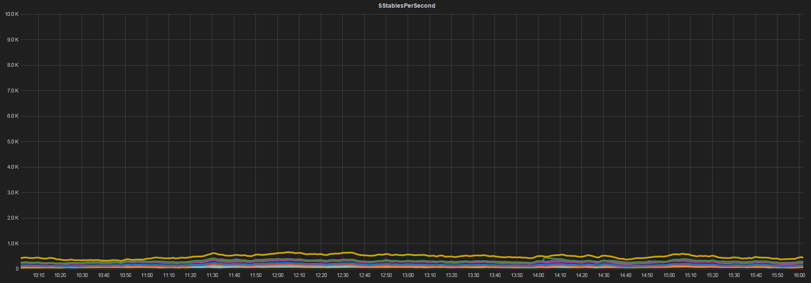
SSTablesPerSecond: after
Notes:
And here is graphic after our fixes. Impressive difference.

Slide 45
What about our goal?
Before:
Client read latency (99th percentile): 100ms – 2s
CPU: 40% – 80%
After:
Client read latency (99th percentile): 50ms – 200ms
CPU: 20% – 50%
Notes:
What about our main goal?
Both latency and CPU was reduced, comparison on the slide.
Good result, but not excellent. We wanted better result, for being safe.

Slide 46
Profile again
Reading SSTables vs reading Memtable – 50/50
SliceQuery – 70%
Notes:
So, we profiled a Cassandra node again. Time spent in reading SSTables became equals to time spent in reading Memtable.
And 70 percent of time was in processing slice queries.
So, the question was: what tables generated this high activity?

Slide 47
Look at metrics again
LiveScannedHistogram
how many live columns node scans per slice query
TombstonesScannedHistogram
how many tombstones node scans per slice query
Notes:
For answer, we looked at the metrics again.
On the slide there are two useful metrics for analyzing slice request activity.
LiveScannedHistogram: histogram of the number of scanned live columns per slice query
TombstonesScannedHistogram: histogram of the number of scanned tombstones per slice query
But again, we did not find any anomalies in this metrics.

Slide 48
Look at metrics again
LiveScannedHistogram
how many live columns node scans per slice query
TombstonesScannedHistogram
how many tombstones node scans per slice query
Not found any anomalies
Notes:
For answer, we looked at the metrics again.
On the slide there are two useful metrics for analyzing slice request activity.
LiveScannedHistogram: histogram of the number of scanned live columns per slice query
TombstonesScannedHistogram: histogram of the number of scanned tombstones per slice query
But again, we did not find any anomalies in this metrics.

Slide 49
Look at metrics again
LiveScannedHistogram
how many live columns node scans per slice query
TombstonesScannedHistogram
how many tombstones node scans per slice query
Not found any anomalies
Why not use the successful trick?
Notes:
For answer, we looked at the metrics again.
On the slide there are two useful metrics for analyzing slice request activity.
LiveScannedHistogram: histogram of the number of scanned live columns per slice query
TombstonesScannedHistogram: histogram of the number of scanned tombstones per slice query
But again, we did not find any anomalies in this metrics.

Slide 50
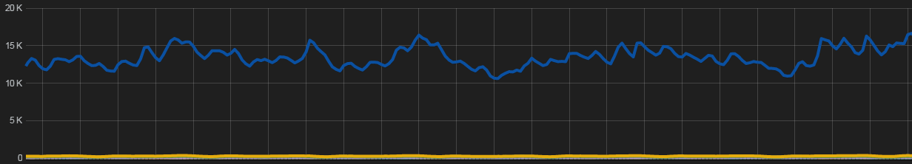
LiveScannedPerSecond
how many live columns Cassandra scans per second for each table
LiveScannedHistogram.Mean * ReadLatency.OneMinuteRate
Notes:
We tried to use successful trick and built metric LiveScannedPerSecond: how many live column Cassandra scans per second for each table.
The formula and our graph on the slide.

Slide 51
LiveScannedPerSecond: results
1 obvious leader
Large difference between leader and others
Leader – big surprise
Notes:
The results of analyzing this metric were following:
1 obvious leader with a large difference between it and others
And leader was big surprise.
It was the table we used for calculating unimportant background statistics. And because of bug we scanned bigger slices than needed.
So, we simply fixed the bug.

Slide 52
LiveScannedPerSecond: results
1 obvious leader
Large difference between leader and others
Leader – big surprise
Fix: fixed the bug
Notes:
The results of analyzing this metric were following:
1 obvious leader with a large difference between it and others
And leader was big surprise.
It was the table we used for calculating unimportant background statistics. And because of bug we scanned bigger slices than needed.
So, we simply fixed the bug.

Slide 53
What about our goal?
Initial:
Client read latency (99th percentile): 100ms – 2.0s
CPU: 40% – 80%
After SSTablesPerSecond fixes:
Client read latency (99th percentile): 50ms – 200ms
CPU: 20% – 50%
After LiveScannedPerSecond fixes:
Client read latency (99th percentile): 30ms – 100ms
CPU: 10% – 30%
Notes:
What about our main goal?
Both latency and CPU was reduced, comparison on the slide.
Good result, but still not enough for us.

Slide 54
Profile again
Compaction – 30%
Notes:
And we profiled node again and found that node spend 30% of time in compaction.
For fix it we just throttled down compactions during high load period and throttled up it during low load period.

Slide 55
Profile again
Compaction – 30%
Fix:
throttled down compactions during high load period,
throttled up during low load period
Notes:
And we profiled node again and found that node spend 30% of time in compaction.
For fix it we just throttled down compactions during high load period and throttled up it during low load period.

Slide 56
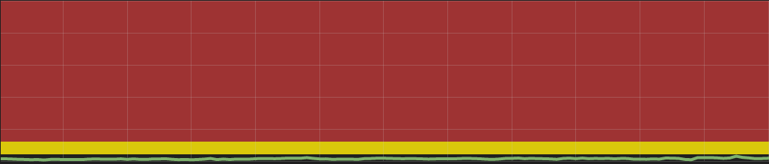
What about our goal?
Notes:
Let’s look at the client latency difference before and after all these fixes.

Slide 57
What about our goal?
Initial:
Client read latency (99th percentile): 100ms – 2.0s
CPU: 40% – 80%
After LiveSkannedPerSecond fixes:
Client read latency (99th percentile): 30ms – 100ms
CPU: 10% – 30%
After Compaction fixes:
Client read latency (99th percentile): 10ms – 50ms
CPU: 5% – 25%
Notes:
And these results in numbers.
We reduced upper limit of latency from 2 seconds to 50 milliseconds.

Slide 58
More metrics!
TombstonesScannedPerSecond
KeyCacheMissesPerSecond
…
Notes:
Thera are many metrics that could be build from base Cassandra metrics, for example:
TombstoneScannedPerSecond could answer the question: does the cluster waste time in scanning many tombstones?
KeyCacheMissesPerSecond could answer the question: do some tables in the cluster have problems with keyCache?
We made a few small fixes based on the information from these metrics. I have not enough time to tell about them in details.
But after all these fixes we got following results:
50 times less at average! It was unbelievable for us, because we did not do something extraordinary.
Almost fixes was pretty simple, some of them did not require coding, only settings tuning.
And we still use this metrics not only to investigate problems, but for check our data model assumptions in production.
For example, we expected that some table will scan very few tombstones. A simple look at TombstonesScannedPerSecond metric can answer if is it true or not.
To wrap up, I recommend to try calculating these metrics on your cluster. Probably you will get some surprises like we got.

Slide 59
More metrics!
TombstonesScannedPerSecond
KeyCacheMissesPerSecond
…
Initial:
Client read latency (99th percentile): 100ms – 2.0s
CPU: 40% – 80%
After all fixes:
Client read latency (99th percentile): 5ms – 25ms 50 times less at average!
CPU: 5% – 15% 7 times less at average
Notes:
Thera are many metrics that could be build from base Cassandra metrics, for example:
TombstoneScannedPerSecond could answer the question: does the cluster waste time in scanning many tombstones?
KeyCacheMissesPerSecond could answer the question: do some tables in the cluster have problems with keyCache?
We made a few small fixes based on the information from these metrics. I have not enough time to tell about them in details.
But after all these fixes we got following results:
50 times less at average! It was unbelievable for us, because we did not do something extraordinary.
Almost fixes was pretty simple, some of them did not require coding, only settings tuning.
And we still use this metrics not only to investigate problems, but for check our data model assumptions in production.
For example, we expected that some table will scan very few tombstones. A simple look at TombstonesScannedPerSecond metric can answer if is it true or not.
To wrap up, I recommend to try calculating these metrics on your cluster. Probably you will get some surprises like we got.

Slide 60
Thank you
Notes:
Thank you!

Slide 61
Extra: The effect of the slow queries
pending tasks
concurrent_reads

